Slide 1
A database and tools for 3-D protein structure comparison and alignment using the Combinatorial Extension (CE) algorithm
Ilya N. Shindyalov and Philip E. Bourne
Nucleic Acids Res. 2001 January 1; 29(1): 228–229.

Slide 2
Abstract
The database reported here is derived using the Combinatorial Extension (CE) algorithm which compares pairs of protein polypeptide chains and provides a list of structurally similar proteins along with their structure alignments. Using CE, structure–structure alignments can provide insights into biological function. When a protein of known function is shown to be structurally similar to a protein of unknown function, a relationship might be inferred;

Slide 3
a relationship not necessarily detectable from sequence comparison alone. Establishing structure–structure relationships in this way is of great importance as we enter an era of structural genomics where there is a likelihood of an increasing number of structures with unknown functions being determined. Thus the CE database is an example of a useful tool in the annotation of protein structures of unknown function. Comparisons can be performed on the complete PDB or on a structurally representative subset of proteins.

Slide 4
The source protein(s) can be from the PDB (updated monthly) or uploaded by the user. CE provides sequence alignments resulting from structural alignments and Cartesian coordinates for the aligned structures, which may be analyzed using the supplied Compare3D Java applet, or downloaded for further local analysis. Searches can be run from the CE web site, http://cl.sdsc.edu/ce.html, or the database and software downloaded from the site for local use.

Slide 5
Introduction
Automated methods
Manually applying biological knowledge
The database presented here provides that automated starting point.

Slide 6
Feature
To find all similar structures to a starting polypeptide chain that is >30 residues in length and already in the PDB
Calculate similar structures starting with a structure not in the PDB
Calculate the alignment between two polypeptide chains

Slide 7
Find similar structures already in the PDB
Randomly selected from a pool of all chains
Compared against a list of structure representatives

Slide 8
If the new chain is similar to one of the structure representatives then it is assigned to that representative and becomes the representing chain.
If the new chain is unique it becomes a new representative and is added to the representatives’ list.

Slide 9
Criteria
The RMSD between two aligned chains is <2 Å
The difference in chain length is <10%
The number of aligned positions is at least two-thirds the length of the represented chain
The number of gap positions in the alignment is <20% of the number of aligned positions

Slide 10
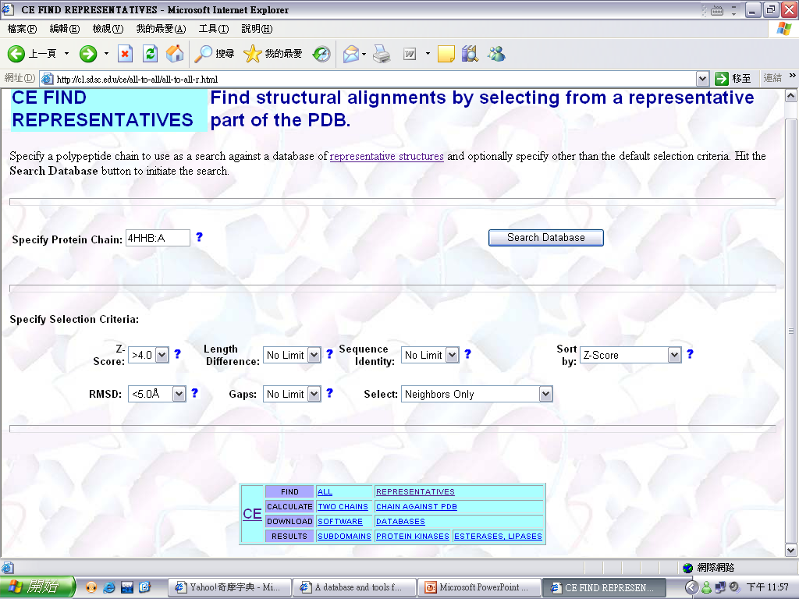

Slide 11
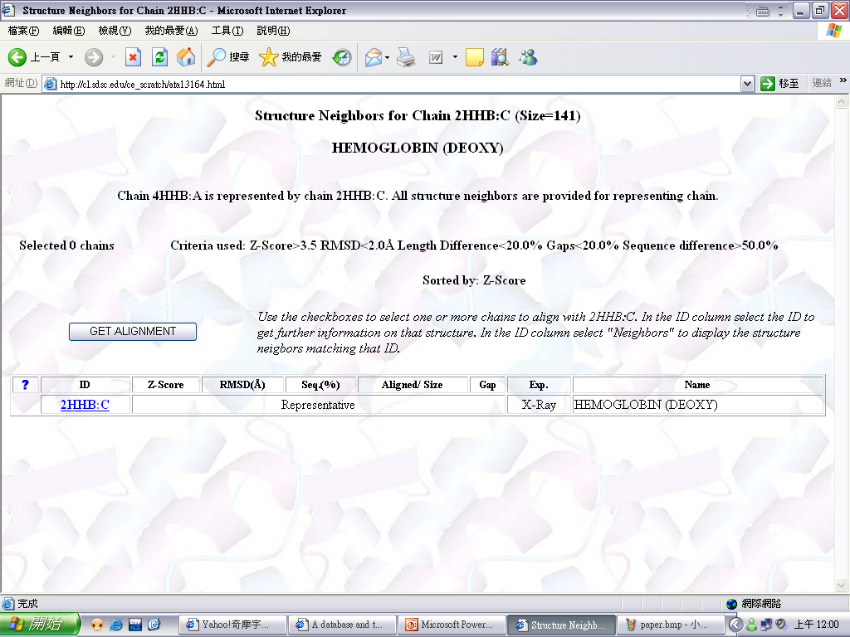

Slide 12
